Slide 1
Angular 8 - Day 1
Introduction to Angular

Slide 2
Vignesh Murali Natarajan (119780)
Veteran Trainer, Project Manager and Solution Architect with 14 years of technical training experience and 12 technical certifications on Java, Mobile, Web, Architecture, Design and Development
v2.1 May 2019
Edited By Jason Monroe (688776)

Slide 3

Session Rules
There is no set time to ask questions, feel free to interrupt, should you have questions.
There will be a 10 minutes short break around the middle of the session.
Utilize the time provided by the trainer, in analyzing examples, trying out exercises and formulate questions.

Slide 4

Context Setting: Overview
Intro
SPA, RWD
Angular Versions
Basics
Components
Component Interaction
Advanced
Routing
Directives
Http
Pipes
Landscape
Hello World
Services

Slide 5

Objectives
After completing this session, you will be able to comprehend the following topics:
Introduction to SPA
Workspace Setup
Introduction to Angular
Angular JS vs Angular
High Level Architecture
Hello Angular !!

Slide 6
Objectives
Walk Through Angular Project
angular.json
index.html
main.ts
app.module.ts
app.component.ts
app.component.html
Assets folder

Slide 7
Introduction to SPA

Slide 8
Single Page Applications
Single-Page Applications (SPAs) are Web apps that load a single HTML page and dynamically update that page, as the user interacts with the app.
SPAs use AJAX and HTML5 to create fluid and responsive Web apps, without constant page reloads. This means much of the work happens on the client side, in JavaScript.

Slide 9
Single Page Applications (Contd.)
Web app that fits on a single web page is Fluid UX, similar to a desktop app. Few examples would be Gmail, Google maps and so on
Html page contains mini--‐views (HTML Fragments) that can be loaded in the background
No reloading of the page, hence better User Experience
Requires handling of browser history, navigation and bookmarks

Slide 10
Responsive Web Design
Responsive Web Design (RWD) is an approach to web design, aimed at crafting sites to provide an optimal viewing experience, easy reading and navigation with a minimum of resizing, panning, and scrolling, across a wide range of devices (from desktop, computer monitors to mobile phones).
A responsive theme's layout adjusts to your device's screen size. It provides an optimal viewing experience, easy reading and navigation on mobile phones, tablets, laptop and desktop computers.

Slide 11

Responsive Web Design
Rise of RWD and SPA

Slide 12
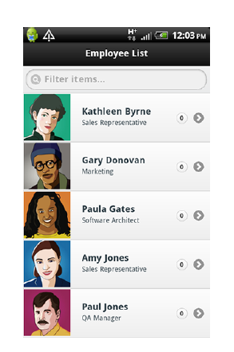
Why Responsive Web Design?
Unified across experiences
Can be embedded as a mobile app
Better deployment and maintenance
Mobile users need to get access to everything

Slide 13
Challenges in SPA
DOM Manipulation: How to manipulate them effectively
History: What happens at the push of the browser back button
Routing: Readable URLs?
Data Binding: How to Bind Data from Model to View
View Loading: How to load the view
Lot of coding! A framework to the rescue

Slide 14
Workspace Setup

Slide 15
Required Software
Required Software:
Node-v10.x https://nodejs.org/en/download/
Visual Studio Code
Additional Setup:
After the installation of node, ensure that you install the following, using Node Package Manager(npm):
Angular CLI
$ npm install -g @angular/cli

Slide 16
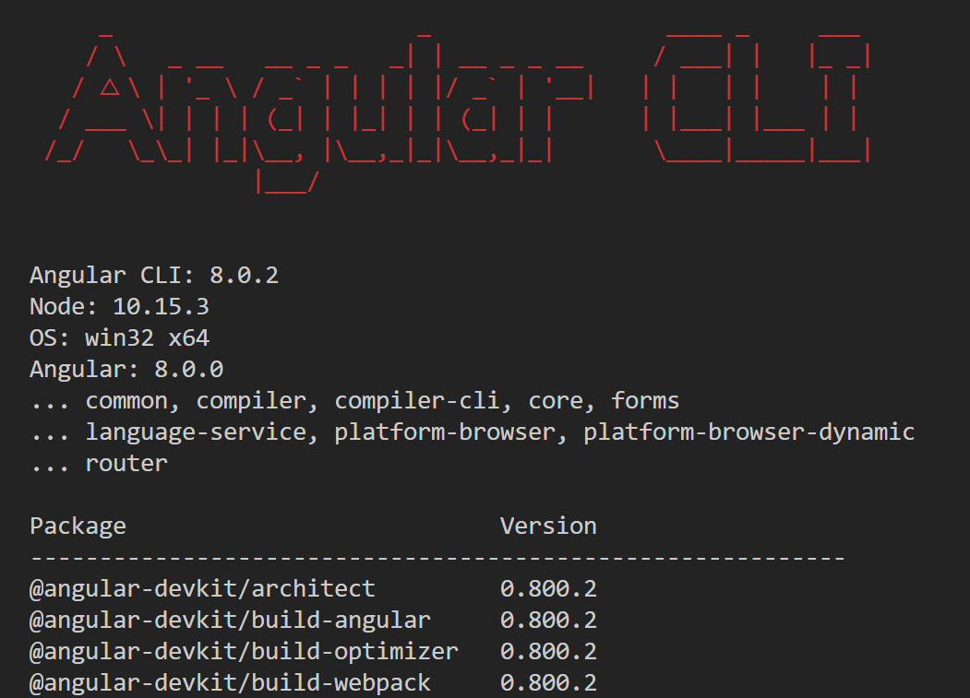
Verify Version with ng --version

Slide 17
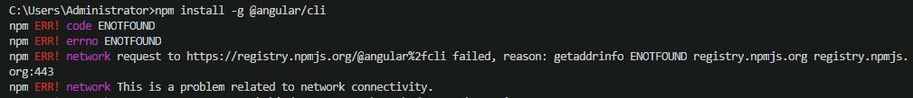

Required Software
Additional Setup (Continued):
If you are behind a proxy, you might get the following error:
Configure npm to handle proxy:
Example:
$ npm config set proxy http://<<address>>:<<port>>
$ npm config set https-proxy http://<<address>>:<<port>>

Slide 18
Introduction to Angular

Slide 19
Angular
Angular 2+ (commonly referred to as ‘Angular’) is a Typescript-based open-source front-end web application platform, led by the Angular Team at Google.
One way to build applications and reuse your code and abilities to build apps for any deployment target. For web, mobile web, native mobile, and native desktop.
Achieve the maximum speed possible on the Web Platform and take it further, through Web Workers and server-side rendering.
Angular is a complete rewrite from the same team that built AngularJS.

Slide 20
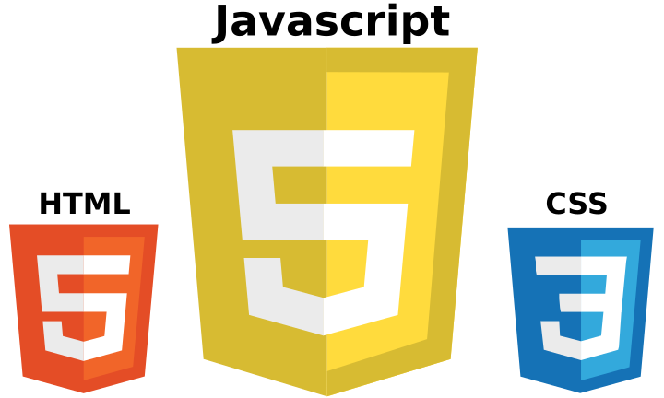
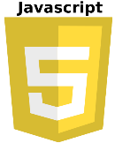



Angular Landscape
Typescript
ES6
(JS Tomorrow)
ES5
(JS Today)
Strong Typing
Decorators (Annotations)
Classes
Modules
Arrow Functions
Target
Needs Shim to execute ES6
Flow
Typescript
Javascript
Transpile

Slide 21
Why Angular?
Distilled all the best practices of Angular 1.x into Angular 7 (See Appendix 1 in this Deck)
By focusing on standards, we get twice the power with half the framework
Reactive mechanisms baked into the framework like two-way binding
The tooling support is as good as on Java or .Net platforms
Using TypeScript classes and interfaces makes the code more concise and easy to read and write

Slide 22
Why Angular?
Clean separation between the code that renders UI and the code that implements application logic
The UI does not have to be rendered in HTML. There are already products, supporting native UI rendering for iOS and Android
The TypeScript compiler generates JavaScript that a human can read and compile into ES3, ES5, or ES6 versions of JavaScript

Slide 23
Why Angular?
Dependency injection gives you a clean way to implement loose coupling between components and services.
Automatic (and fast) change detection mechanism spares you from the need to manually force UI updates, while giving you a way to fine-tune this process.
Angular comes with the Rx.js library, which allows you to arrange a subscription-based processing of asynchronous data and eliminates the callback hell.
An ability to pre-compile the code eliminates the need to package Angular Module Loader (not to be confused with TypeScript compiler) with your app, which further minimizes the overhead of the framework.
The scaffolding and deployment tool (Angular CLI) spares developers from writing the boilerplate code and configuration scripts.

Slide 24
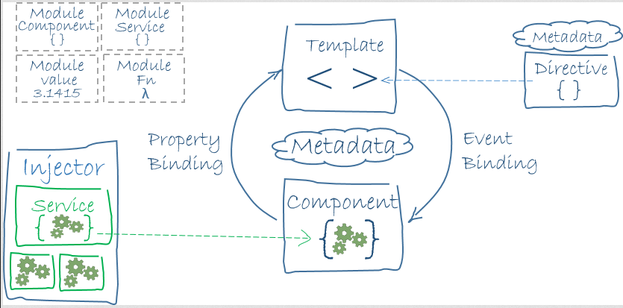
Angular Architecture
Application
Framework
Router
Http
Compiler
Platform
Core and Common
Libraries
Rx
Reflect
Zone
System
Shim

Slide 25
Hello Angular !

Slide 26
Hello Angular – NG Way
To create a new project, from a terminal window, go to the folder where you want to create the project and issue the command below:
Base project files creation and dependency resolution will be done by Angular CLI for you
When the above command completes successfully, launch the Angular application by running the command
Launches the index.html in a browser @ http://localhost:4200 (port might vary)
Eureka!!
Parameter Decorator
$ ng new <<your-project-name-here>>
$ ng serve --o

Slide 27
Angular Deployment
https://angular.io/guide/deployment
Ng serve
In-memory compilation running on local server
File changes trigger reload for iterative development
Ng build
Creates output folder ‘dist’
Consolidates app into a few js files
Assets folder replicated
Must change base href for deployment environment

Slide 28
Hello Angular – NPM Way
Manually create a folder on you dev machine, navigate to it in a terminal, then create the angular substrate by running the below command:
Inspect the files and folders generated, particularly the package.json file. Only the name, description and scripts attributes are of significance in that file as of now.
Add dependencies – Angular, SystemJS, Live-server, TypeScript compiler
Run the install command to install the above dependencies
Parameter Decorator
$ npm init -y
$ npm install

Slide 29
Hello Angular – NPM Way
Copy the following files - SystemJS Config file, index.html, main.ts, app.module.ts and app.component.ts
Launch the Angular application by running the command
Launch the index.html in a browser @ http://localhost:4200/index.html (port might vary)
Eureka!!
Parameter Decorator
$ npm start

Slide 30
Angular Project Structure

Slide 31
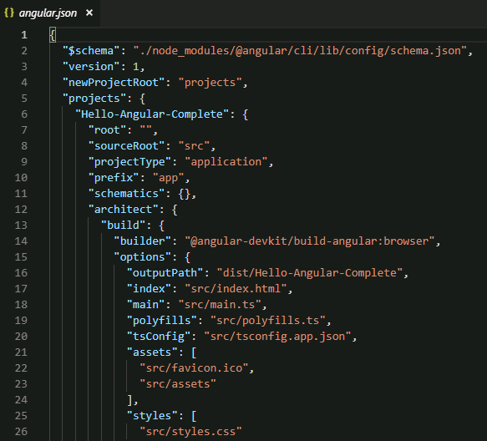
angular.json
“outputPath” is the location where the ng build command places the condensed js files for the entire app
index.html is the single page in which the Angular App is injected
main.ts is the “main” Angular entry point
polyfills.ts contains browser compatibility polyfills and application polyfills.
styles.css is where global styles can be placed. Any CSS rules you place here are injected into the DOM in a <style></style> tag
“assets” array describes the location of static file assets

Slide 32
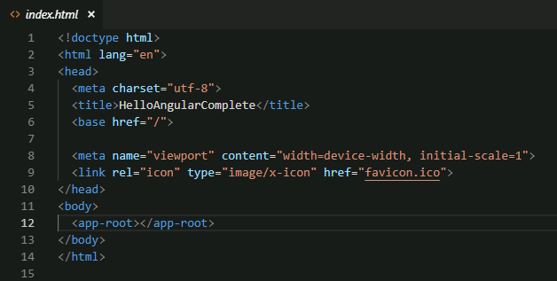
index.html
Angular content is injected in the <app-root></app-root> tag

Slide 33
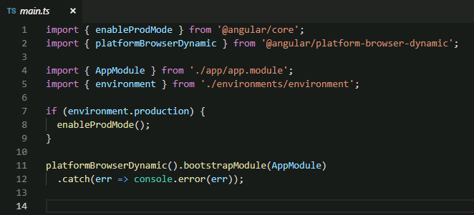
main.ts
AppModule is a TypeScript class (imported from /app/app.module) that is being bootstrapped on line 11 as the Angular start-up module.

Slide 34
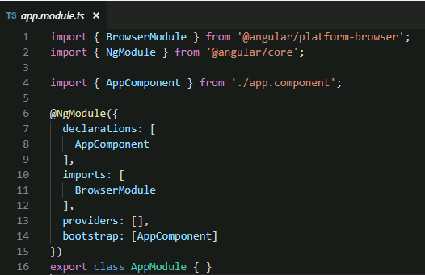
app.module.ts
AppComponent is a TypeScript class (imported from /app/app.component) that is being bootstrapped on line 14 as the initial component for the module.

Slide 35
Bootstrapping
Bootstrapping is an essential process in Angular 5 where the application is loaded when Angular comes to life.
The key files in an Angular application include -
app/app.component.ts - Root component is defined here.
app/app.module.ts - Entry Angular Module to be bootstrapped is defined here.
index.html - Page the components are rendered in.
app/main.ts - Glue that combines the component and page.
The bootstrap process loads main.ts which is the main entry point of the application. The bootstrap code should be confined to the main.js file.
Angular is not a web-only based framework. Components that can run in NativeScript, Cordova etc can also be written.
Bootstrapping is a process interprets imports based on the application platform and the environment.

Slide 36
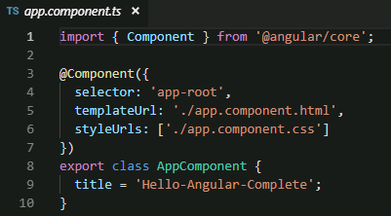
app.component.ts
@Component decorator function selects app-root element in index.html and injects into it the app.component.html combined with the TypeScript in the AppComponent class and app.component.css

Slide 37
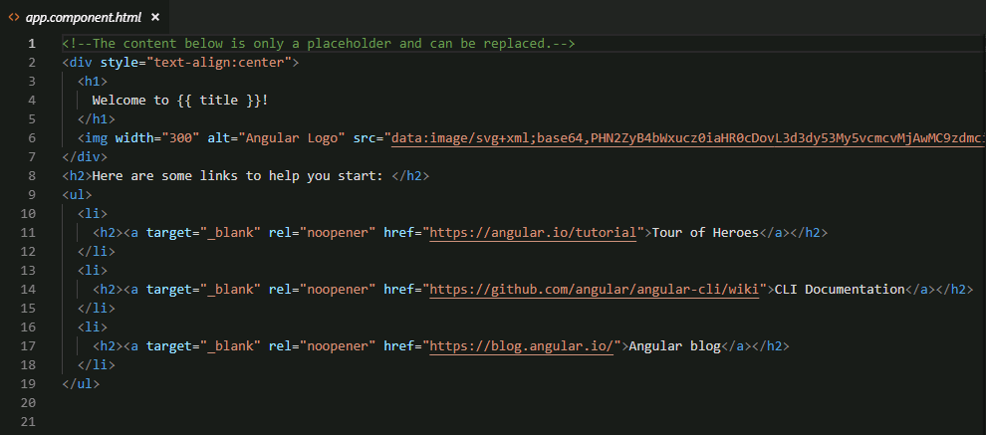
app.component.html
Double curly brace syntax on line 4 instructs Angular to look for a variable named ‘title’ in AppComponent and place its value in the DOM.

Slide 38
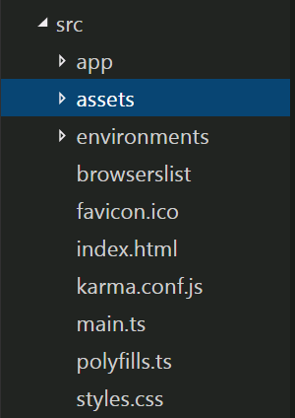
Assets folder
Replicated when Angular project is built
Place any static files here
Can use relative references

Slide 39

Summary
In conclusion, this deck covered the following(but not limited to)
The SPA / RWD Landscape
What is Angular and the distinction between versions
Why use Angular
How to build a simple Angular App
What are the major components in an Angular App

Slide 40

Source
Angular API Documentation
Angular.io
Front End Masters
Rangle.io
Disclaimer: Parts of the content of this course is based on the materials available from the Web sites and books listed above. The materials that can be accessed from linked sites are not maintained by Cognizant Academy and we are not responsible for the contents thereof. All trademarks, service marks, and trade names in this course are the marks of the respective owner(s).

Slide 41
You have successfully completed Angular 8 - Day 1 Introduction to Angular

Slide 42
Thanks!

Slide 43
Appendix 1: Angular Vs Angular 7

Slide 44
Angular 7 vs Angular 1
Angular JS | Angular 7
Uses and built on Javascript. EcmaScript 5 | Used TypeScript, a superset of Javascript. Also supports EcmaScript 6
No Mobile Support | Mobile Oriented, completely decoupled MVVM
$Scope plays a pivotal role | No $Scope. Change Detection is done using Zone.js
No Type support, compilation | Provides Type support and AOT Compilation like other programming language
Controllers ruled the show | No Controllers. Components + Directives compensate instead

Slide 45
Angular 7 vs Angular 1 (Contd.)
////Angular 1.x using Controller and $scope.........
var myApp = angular .module("myModule", [])
.controller("productController", function($scope) {
var prods = { name: "Prod1", quantity: 1 };
$scope.products = prods;
});
///Angular 2 Components using TypeScript........
import { Component } from ‘angular2/core’;
@Component({
selector: ‘prodsdata’,
template: `
<h3>{{techncalDiary}}</h3> `
})
export class ProductComponent {
prods = { name: ‘Prod1’, quantity: 1 };
}

Slide 46
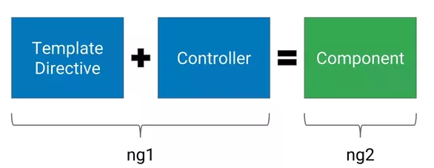
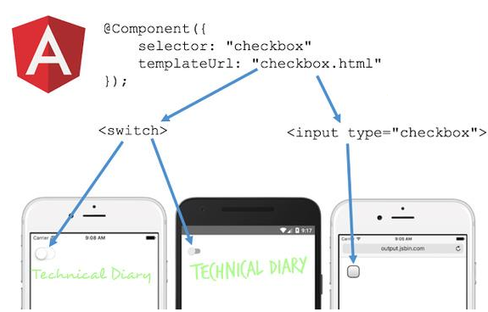
Angular 7 vs Angular 1
Components instead
of Controllers >>
<< Mobile Support with MVVM>>

Slide 47
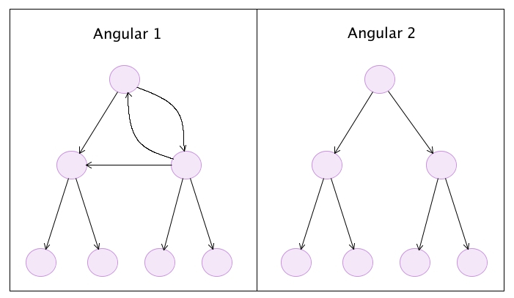
Angular 7 vs Angular 1
Angular 1 against Angular 7 Node Traversal for $Digest

